Slide 1
Lecture 26

Slide 2
Question 123.6.1
Turbulent refers to
Faster or more powerful flow
Flow from two or more sources which mutually increase the total flow velocity
Apparel warn on the head in Middle and Far Eastern countries.
Non laminar flow

Slide 3
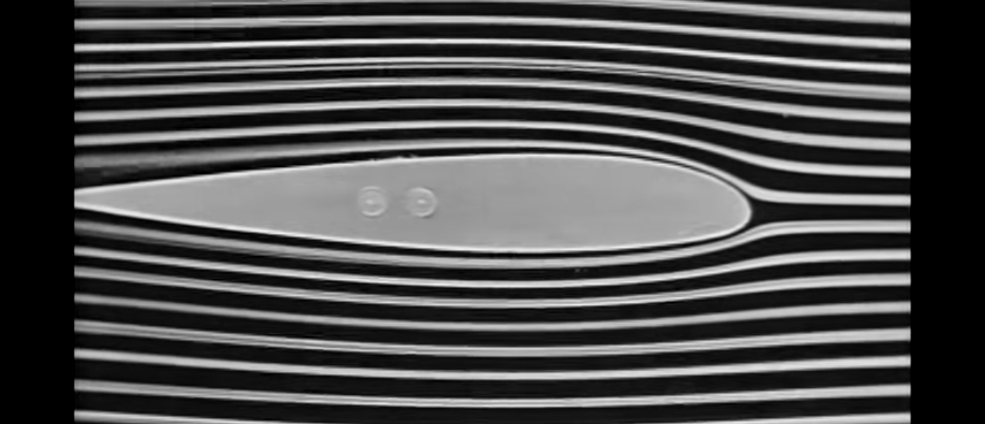
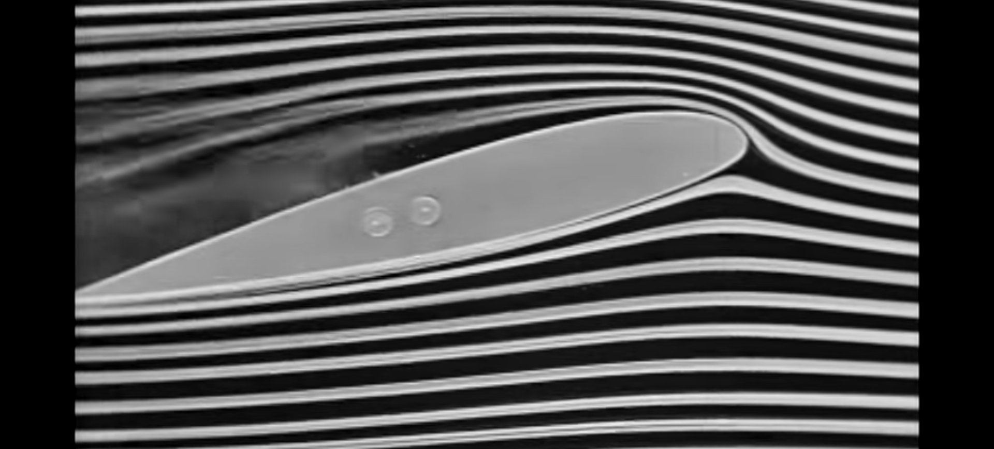
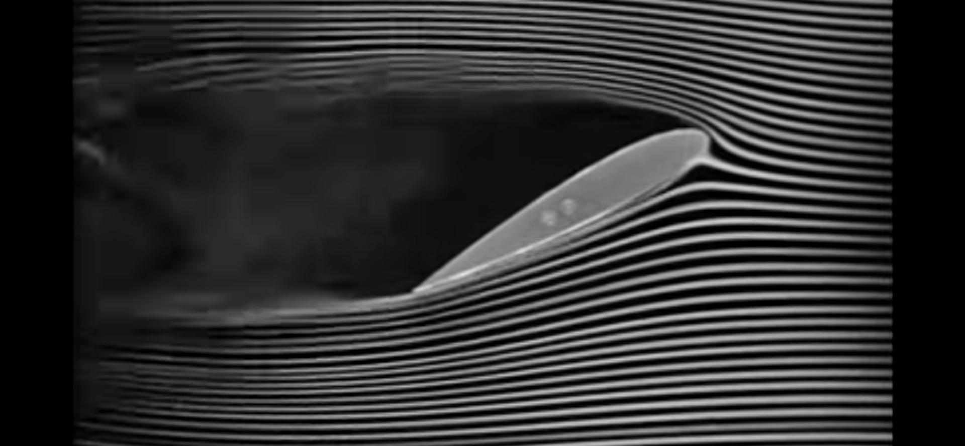
Approximation!
We will limit our study to laminar, nonviscous, irrotational, incompressible fluids.
Laminar Flow
Turbulence
Turbulence

Slide 4
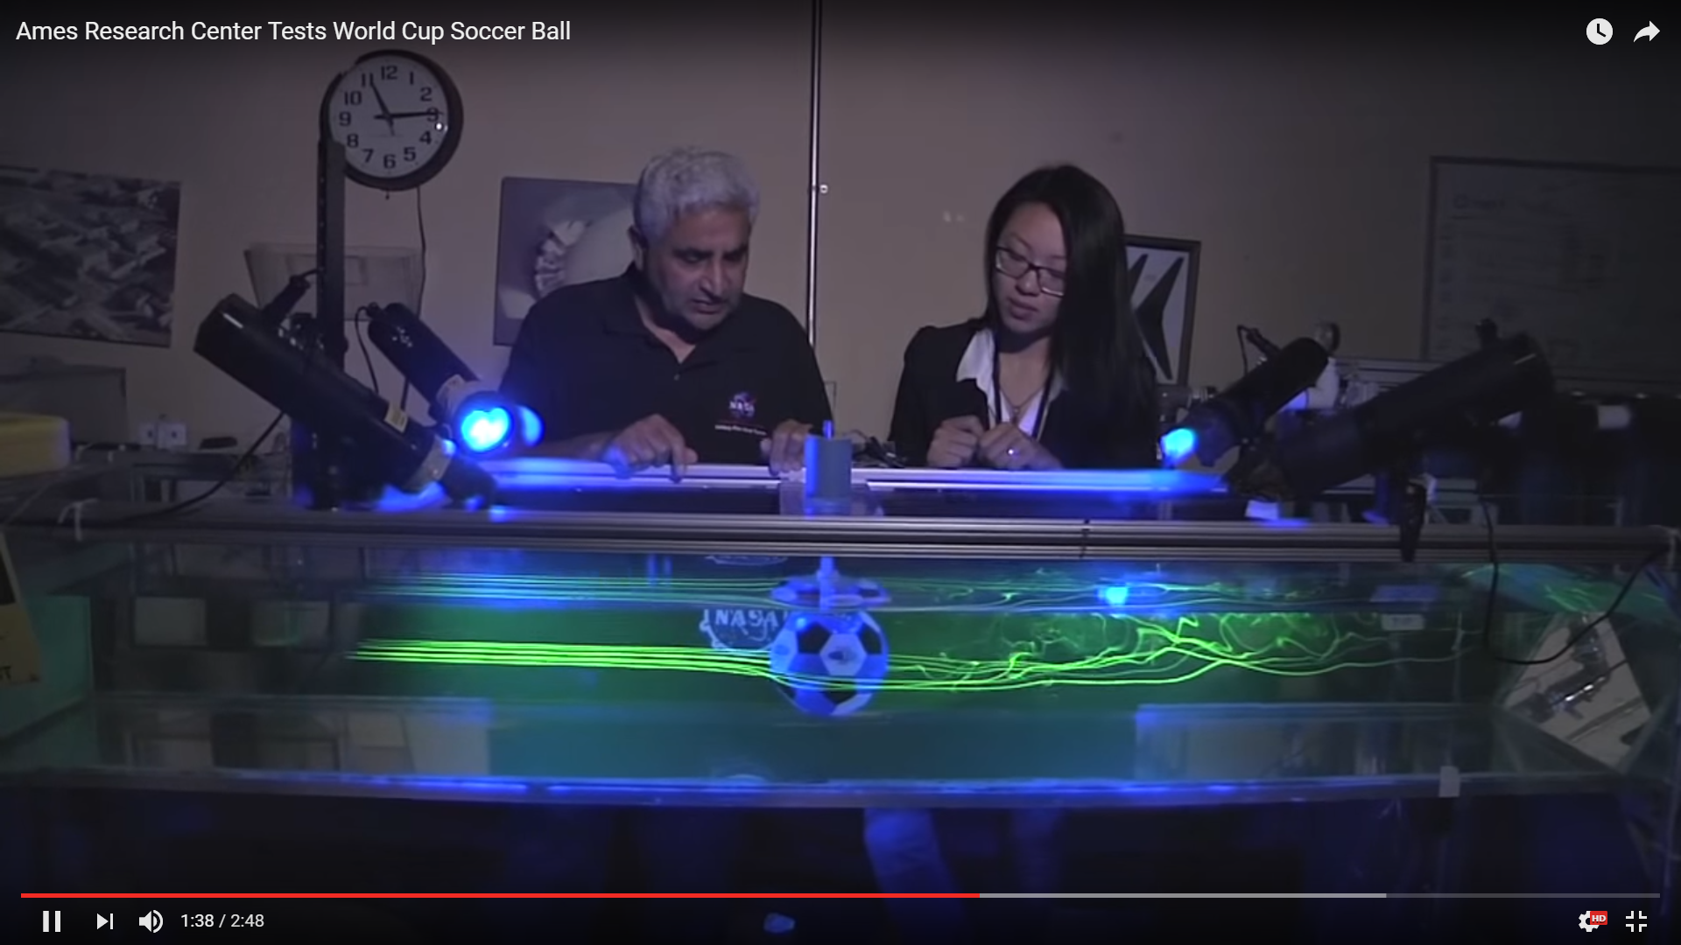
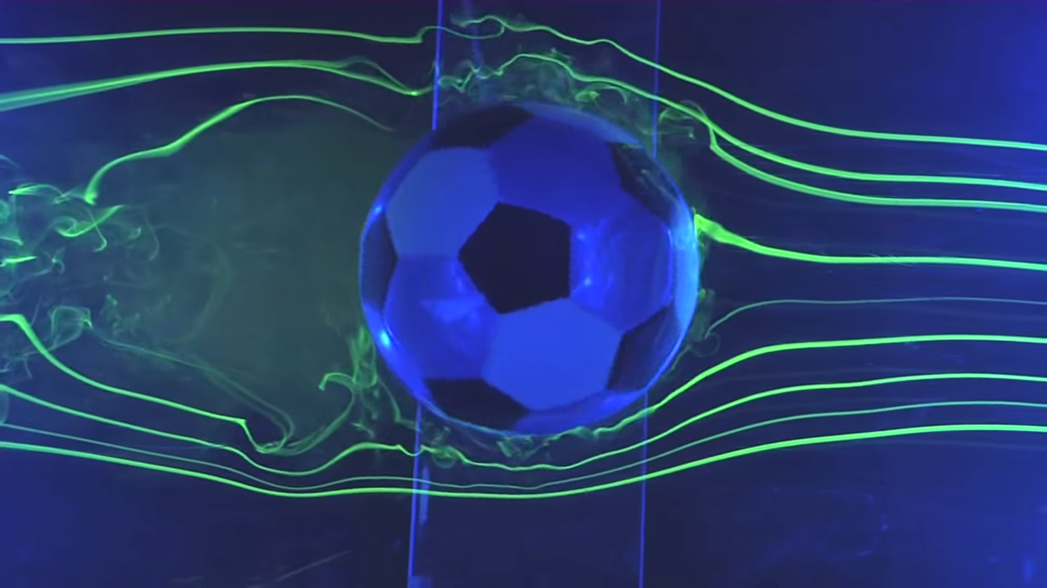

Slide 5
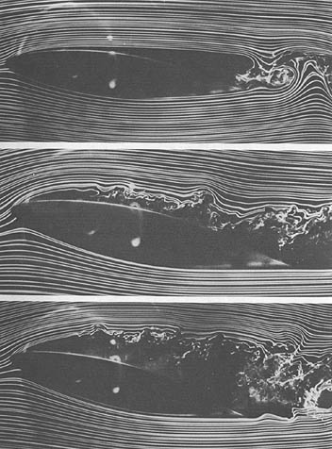

Slide 6
Question 123.6.3
For the purposes of our class a “streamline” is…
A great place to go fishing
A line indicating the path taken by a particle under laminar flow
A line indicating where the maximum flow velocity will occur
A line emanating from a positive charge and terminating at a negative charge.

Slide 7
Question 123.6.2
Which material has the highest viscosity?
Honey
10wt-motor oil
Whole blood
Water

Slide 8
Definitions
Definition Laminar:
Steady flow, if each particle of the fluid follows a smooth path, such that the paths of the different particles never cross each other.
Definition Turbulent:
non-laminar flow characterized by whirlpool or eddy regions
Definition Viscosity:
term describing the internal friction of a fluid (Honey is more viscos than water)
Definition irrotational:
flow having no angular momentum
Definition streamline:
a line indicating the path taken by a particle under steady flow

Slide 9
Question 123.6.5
A non-uniform pipe is shown at the right. Fluid flows from left to right through the pipe segment. How does the flow rate change as we go from point A to point B.
Increases
Decreases
Stays the same
B
A

Slide 10
Equation of Continuity
Imagine a segment of fluid as shown in the top figure
The volume at the right end that is Δx₂ long is not part of the segment
In time Δt the segment moves so the left hand boundary has traveled through Δx₁ and the right hand boundary has traveled through Δx₂
The bottom figure is the one from the book that tries to describe this all in one figure
Δx₂
Δt
Δx₁
Δx₂
Δx₁
v₂
y₂
y₁
v₁

Slide 11
Question 123.6.6
(A)
P_{o}
(B)
P>P_{o}
A non uniform tube has a fluid in it as shown in (A). If a pressure greater than atmospheric pressure is applied to the RHS as in case (B), what can be said of the relationship between V₁ and V₂?
P_{o}
P_{o}
V₂
V₁
V₁ = V₂
V₁ > V₂
V₁ < V₂

Slide 12
Continuity Equation
Δx₂
The mass in volume 1
The mass in volume 2
It is as though the mass from area 1 is moved to area 2
Really we move all the segment
We can’t tell parts of the segment apart
Δt
Δx₁
Δx₂
Δx₁
v₂
y₂
y₁
v₁

Slide 13
Continuity Equation
Δx₂
We don’t
Create mass
Destroy mass
Pool mass anywhere along the pipe
So
We can then say
Δt
Δx₁
Δx₂
Δx₁
v₂
y₂
y₁
v₁

Slide 14
Demonstration
https://phet.colorado.edu/en/simulation/fluid-pressure-and-flow

Slide 15
Question 123.6.4
You attach a nozzle to your hose to water your garden. The water now shoots out of the hose farther. Why might that be so?
The inner part of the nozzle probably has a smaller diameter than the hose, so the velocity of the water increases in the nozzle
The nozzle probably has a bigger inner diameter than the hose, so the pressure increases in the nozzle causing a larger force on the water as it exits
The nozzle probably has a small pump inside that increases the water pressure

Slide 16

Question 123.6.8
A blood platelet drifts along with the flow of blood through an artery that is partially blocked by deposits. As the platelet moves from the narrow region to the wider region, it experiences
an increase in pressure
no change in pressure
a decrease in pressure.

Slide 17
Preliminary Question
You stand on a building and throw three balls, each with the same initial speed but with directions as shown, what is their final velocity?

Slide 18
Normal Person
Super Person

Slide 19



Slide 20


Question 123.6.4.5
Super Person and Normal Person go from ground level to the top of a tall building. Which person has done more work?
Super Person
Normal Person
Both the same

Slide 21



Start with a non-uniform pipe
Forces
On the LHS
$$F_{1}=P_{1}A_{1}\hat{x}$$
On the RHS
$$F_{2}={−P}_{2}A_{2}\hat{x}$$
Δx₂
$$F_{2}={−P}_{2}A_{2}\hat{x}$$
v₂
Δx₁
y₂
$$F_{1}=P_{1}A_{1}\hat{x}$$
y₁
v₁

Slide 22


Work done in Δt
From statics or PH121 we remember
Δx₂
Recall from Statics or PH 121
For the LHS
For the RHS
Define a volume, V (Note that this volume is NOT the volume of the entire segment. It is just the part that is Δx₁ long )
Δx₁
$$F_{2}={−P}_{2}A_{2}\hat{x}$$
v₂
$$F_{1}=P_{1}A_{1}\hat{x}$$
y₂
y₁
v₁
So
The total work done is

Slide 23
Kinetic Energy
If we think about the energy of the segment, we will realize that after time Δt it is as though most of the fluid did not move.
We can't tell one part of the fluid from another.
The shaded region in is occupied before and after Δt
We can treat this problem as if we moved fluid from region 1 to region 2 and left the rest of the segment alone!
Δx₁
Δx₂
After Δt
Before Δt

Slide 24

Potential Energy
Δx₂
We can treat the change in gravitational potential energy like we did for kinetic energy.
We work as though we moved a mass m=m₁=m₂ from y₁ to y₂
Δx₁
$$F_{2}={−P}_{2}A_{2}\hat{x}$$
v₂
$$F_{1}=P_{1}A_{1}\hat{x}$$
y₂
y₁
v₁
After Δt
Before Δt

Slide 25
Total Work Done On The System
This is just
Divide by V and use
Sometimes we write this as
W
ΔK
ΔU

Slide 26

Question 123.6.7
Blood flows through a coronary artery that is partially blocked by deposits along the artery wall. Through which part of the artery is the flow speed largest?
The narrow part.
The wide part.
The flux is the same in both parts.

Slide 27
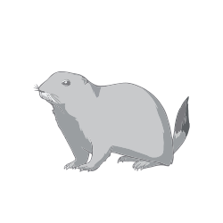
Question 123.6.9
Prairie dogs ventilate their burrows by building a mound around one entrance, which is open to a stream of air when wind blows from any direction. A second entrance is open to almost stagnant air. How does this construction create an air flow through the burrow?
The wind blows directly into the lower hole and out the upper hole
The upper hole is in the wind path, and therefore wind directly enters the upper hole and exits the lower hole
The wind blows faster over the lower hole making a low pressure that creates air flow in the burrow
The wind blows faster over the upper hole, making a low pressure that creates air flow in the burrow

Slide 28
Question 123.6.10
When you golf, you want to put a spin on the ball because
The spin pushes down the air on the bottom of the ball, causing the ball to lift and therefore travel farther
The spin makes the ball fly straighter like a football because it stabilizes its angular momentum
You don’t want to do this because the ball will curve to the side because the air on one side will be less dense than the other because of the spin

Slide 29
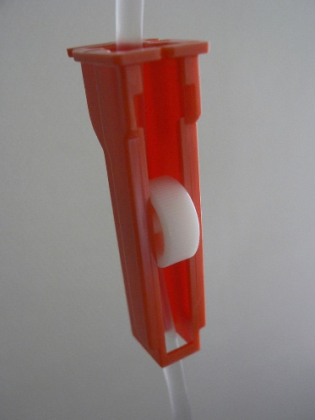

Concept Question
In the picture there is a soldier who has been wounded. He is being given medication by IV. In the IV tube there is a flow regulator (shown in the call out). The device slows the flow of the IV solution. What would happen if the flow were too fast?
The soldier would get better quicker
The soldier’s vein would collapse.
The soldier would be given super powers
Nothing at all, the flow rate is not important.

Slide 30
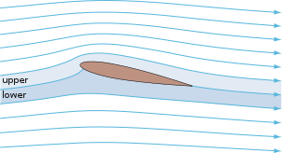
Lower Pressure
Higher Pressure

Slide 31
Question
My wife always tells me that she feels like our car is being sucked into the semi-trucks as we go down the freeway. Knowing Bernoulli’s law, what should I tell her?
You are crazy dear, that can’t be true
The narrow space between the truck and the car makes the air go faster, making a lower pressure, you are being pushed toward the truck.
Big trucks carry large magnets, the car is attracted to the magnets
This is Idaho, the wind always blows you into the neighboring lane.
Sister Lines

Slide 32
Question
Water is flowing down a river. Is the water velocity largest at the top or the bottom or the middle?
Top
Bottom
Middle

Slide 33
v_{t}
v_{b}

Slide 34
Question
We found that the water at the top of the river was fastest (at least for laminar flow). Does this work for air as well?
Yes
No
Kind of

Slide 35
v_{t}
v_{b}

Slide 36
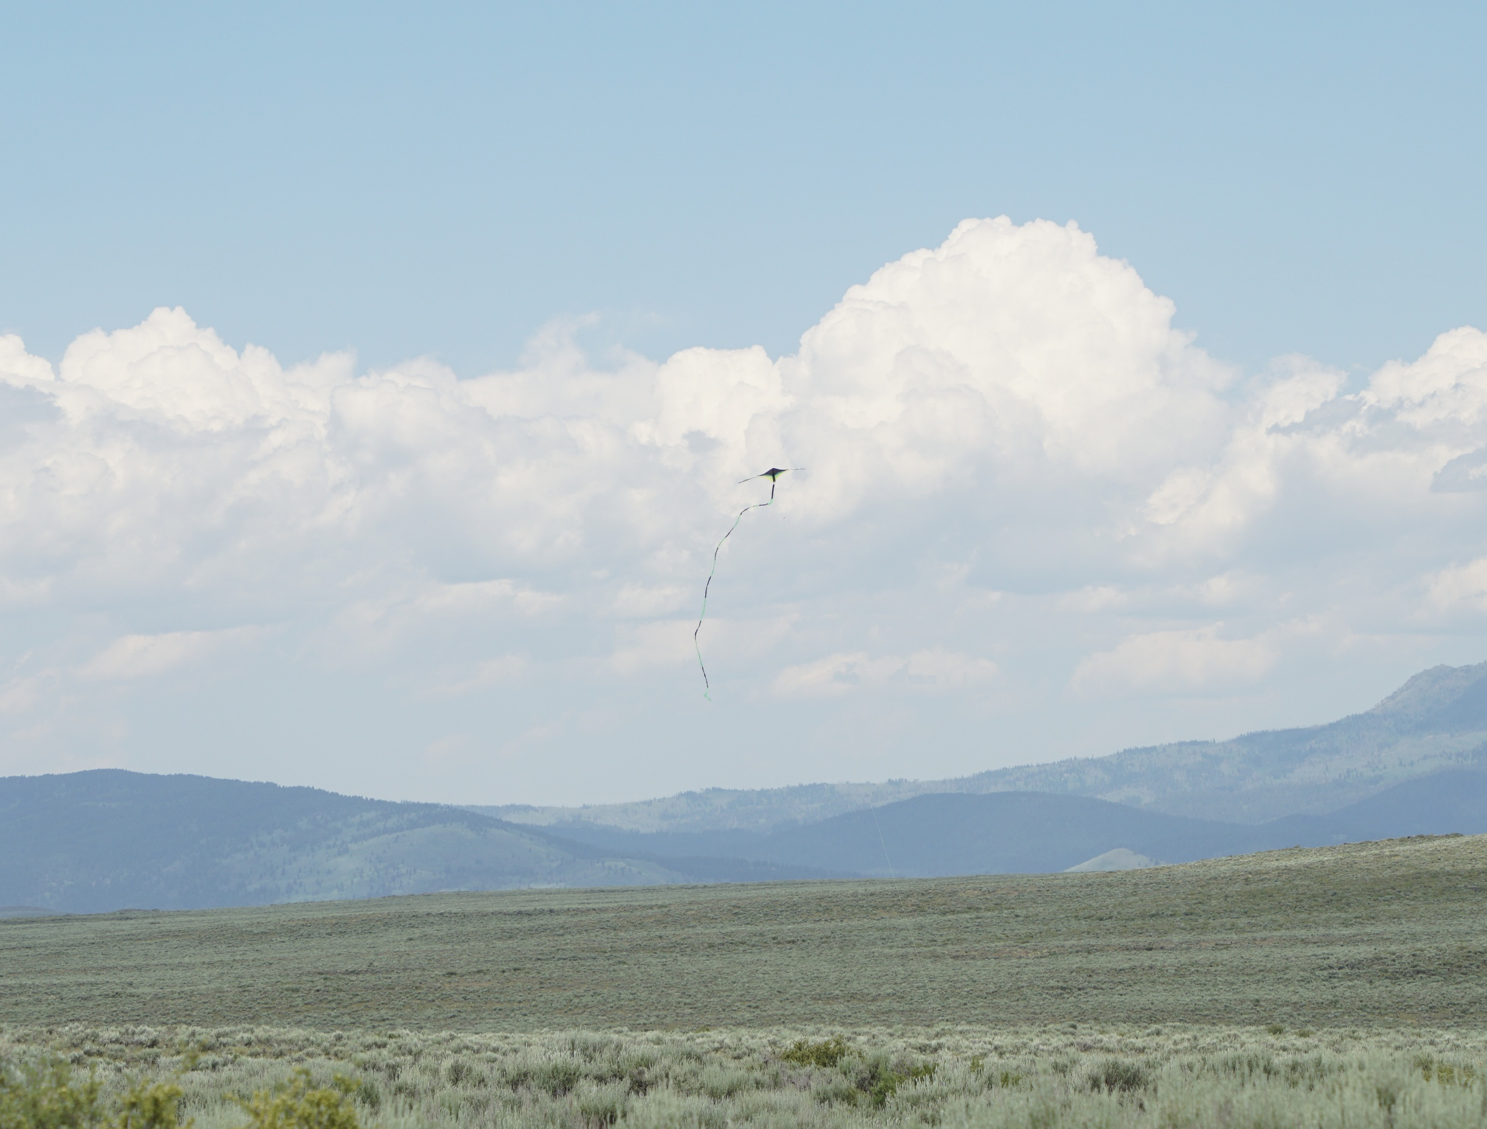

Slide 37
A
F
v
v=0
Δy

Slide 38
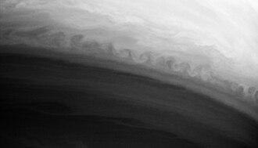
A Kelvin-Helmholtz instability on Saturn, caused by the interaction between two bands of the planet's atmosphere. Image from the Cassini probe. Caption from NASA's press release: This turbulent boundary between two latitudinal bands in Saturn's atmosphere curls repeatedly along its edge in this Cassini image. This pattern is an example of a Kelvin-Helmholtz instability, which occurs when two fluids of different density flow past each other at different speeds. This type of phenomenon should be fairly common on the gas giant planets given their alternating jets and the different temperatures in their belts and zones. The image was taken with the Cassini spacecraft narrow angle camera on October 9, 2004, at a distance of 5.9 million kilometers (3.7 million miles) from Saturn through a filter sensitive to wavelengths of infrared light centered at 889 nanometers. The image scale is 69 kilometers (43 miles) per pixel.

Slide 39
Pressure
In
Pressure
Out
A
A

Slide 40
v_{t}
v_{b}

Slide 42

Question
You have a liquid flowing through a pipe. You for some reason calculate
Where ρ is the liquid density, v is the speed, D is the pipe diameter, and η is the viscosity. You find that the result is less than 2300. You can conclude:
Poiseuille's Law will work
Poiseuille's Law will not work
Nothing, this means nothing to me
$$\frac{ρvD}{η}$$

Slide 43
END

Slide 44
End

Slide 45
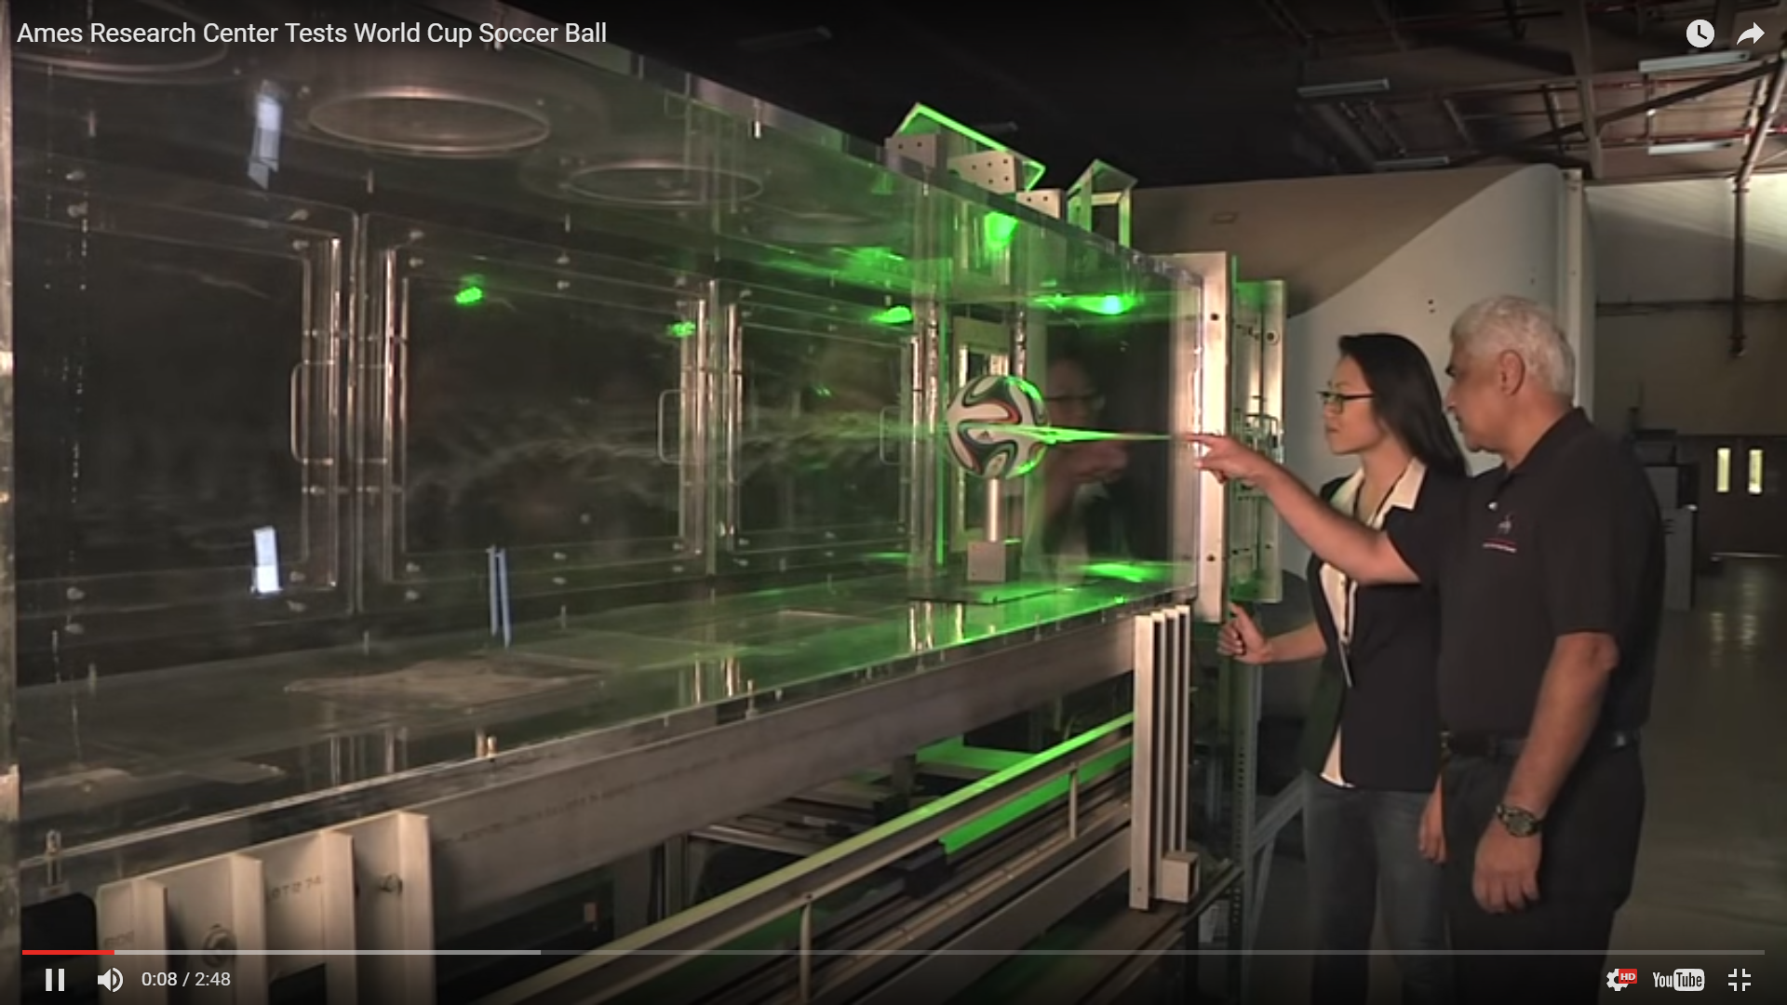

Slide 46
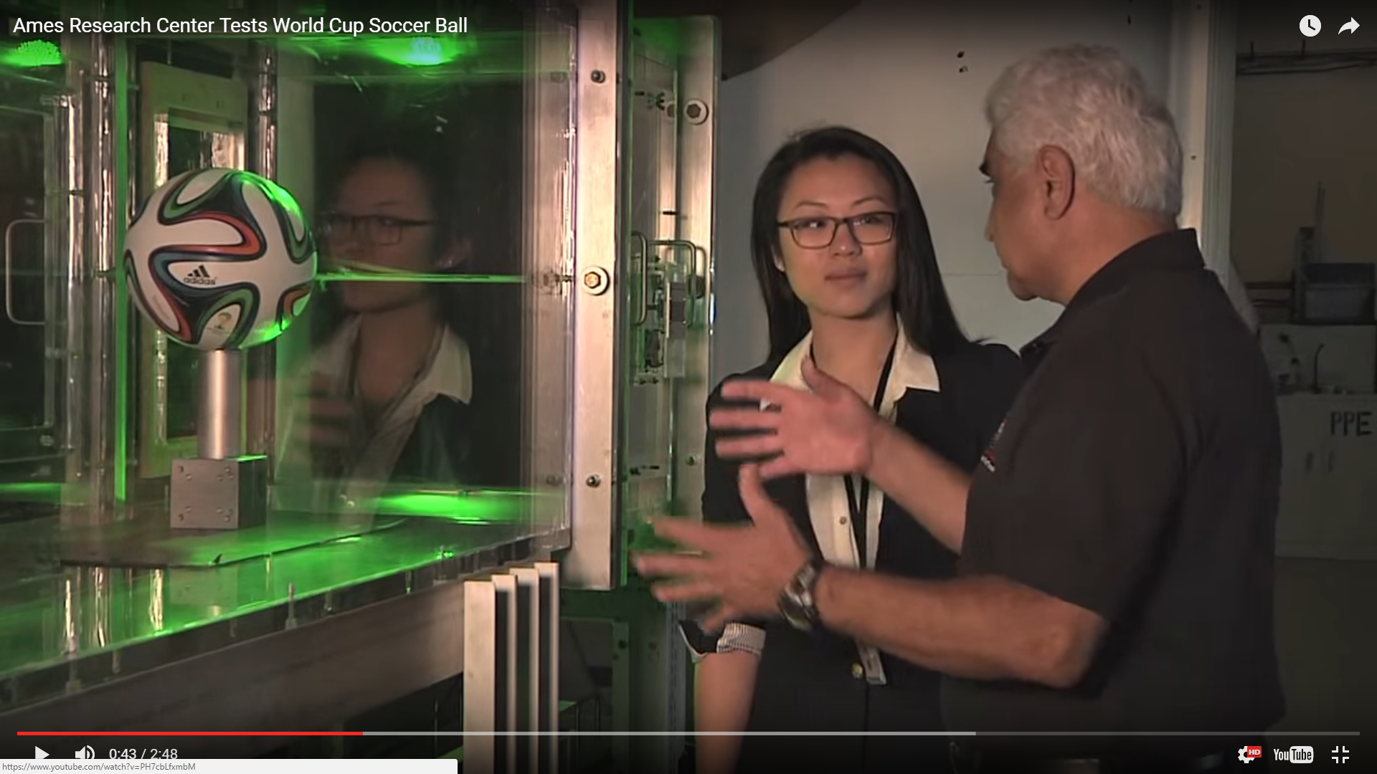

Slide 49


Slide 50
F_{lift}
Lower Pressure
F_{drag}
Higher Pressure

Slide 51
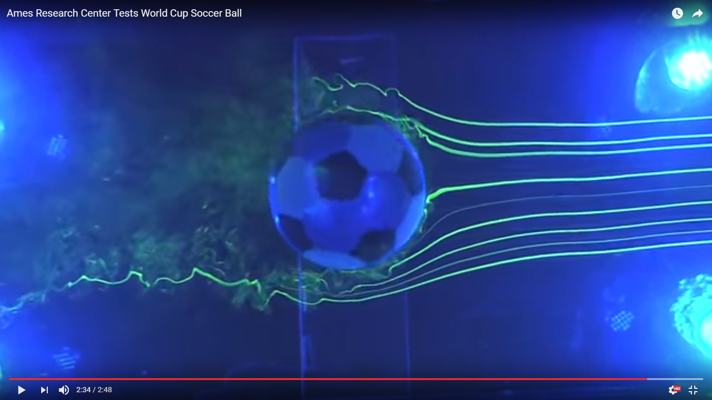

Slide 52
Fluid Flow Direction
Ball Surface Velocity
Fluid Flow Direction
Ball Surface Velocity

Slide 53
Tricks for Problem 6
There is a formula for the area of a sector of a circle
Sector

